Slide 1


Slide 2
Welcome!
Nic Crane, Elucidata: "UseR!2019 Highlights: A Shiny Focus" Deirdre Toher, UWE: "In at the deep end: Lessons learned from teaching R to undergrads" Rich FitzJohn, MRC Centre for Global Infectious Disease Analysis, Imperial College London: "Reproducible research and “productionising” research code"

Slide 3

Thanks to our sponsors!

Slide 4

Thanks to our sponsors!

Slide 5
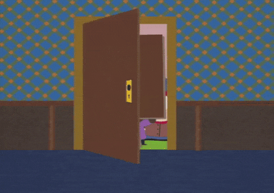
Want to speak at BristolR?
Visit https://tiny.cc/bristolr
Talks of varying length
Maybe run a workshop?

Slide 6
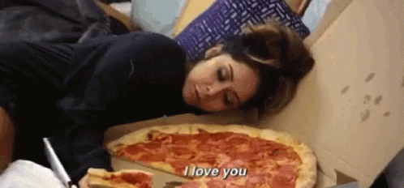
Want to help run BristolR?
Want to help organise meetups?
Help us find more speakers, organise workshops
Or maybe build the website
Or perhaps just introduce speakers?
If you’re interested, join us and get first dibs on pizza!
Get in touch! bristolrusergroup@gmail.com or DM us on Twitter!

Slide 7
Next up…
Nic Crane, Elucidata: "UseR!2019 Highlights: A Shiny Focus" Deirdre Toher, UWE: "In at the deep end: Lessons learned from teaching R to undergrads" Rich FitzJohn, MRC Centre for Global Infectious Disease Analysis, Imperial College London: "Reproducible research and “productionising” research code"

Slide 8
useR! 2019 Highlights
A Shiny Focus

Slide 9

useR! 2019
July 9th – 12th in Toulouse, France
Community-led conference
Talks from academic R, industry R, and everyone in between
Slides:
http://tiny.cc/userslides
Videos now available online:
http://tiny.cc/allusertalks*
http://tiny.cc/rconsortiumvids

Slide 10
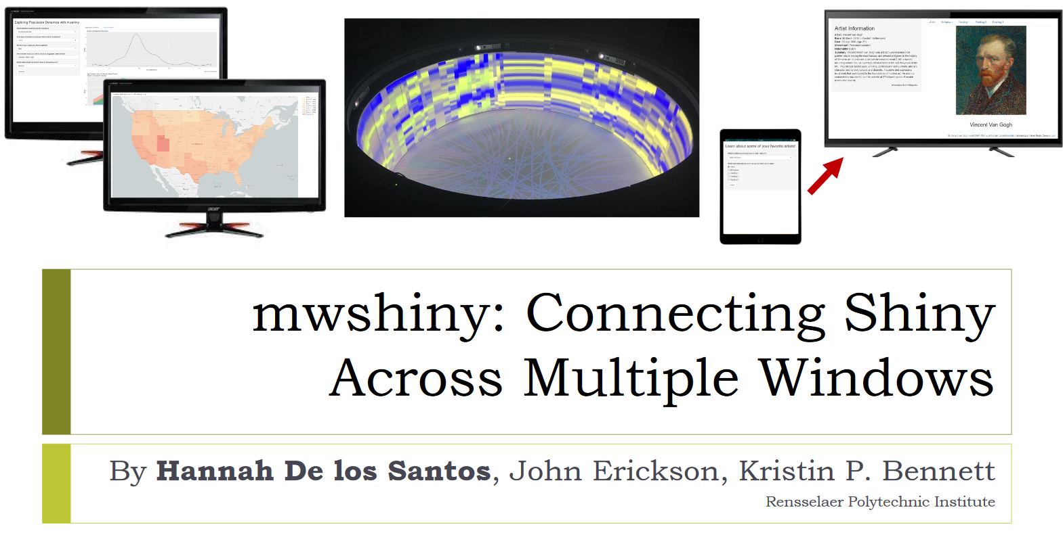
My Personal Highlights
Notes:
Really interesting talk covering a specific use-case; if you want to create a Shiny app that splits content across multiple windows, so for example, across 2 monitors, or maybe controlled from a phone but viewed on a TV screen.
They extend Shiny’s syntax to do it, and if you’re interested, I’d suggested checking it out as it seems pretty well thought out.

Slide 11
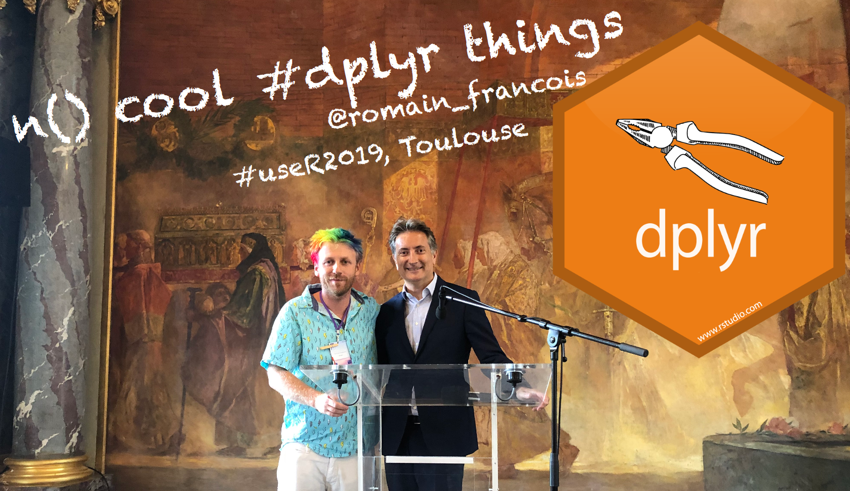
My Personal Highlights

Slide 12

My Personal Highlights

Slide 13
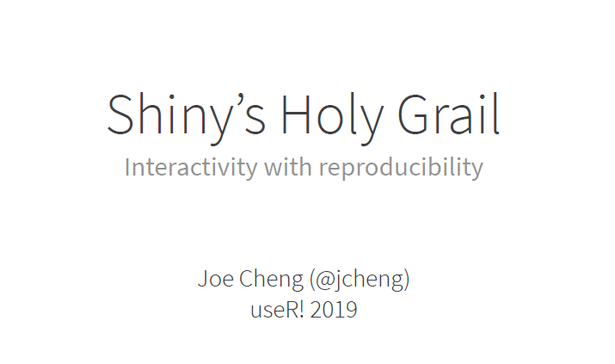
My Personal Highlights

Slide 14
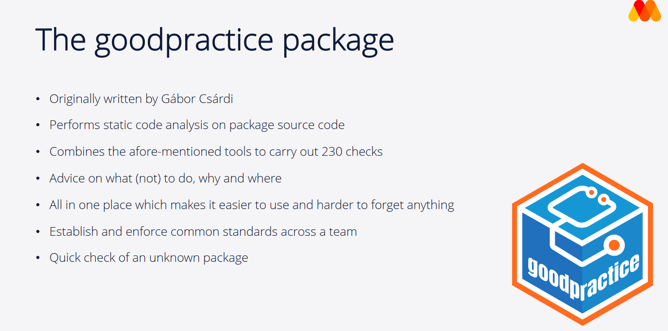
My Personal Highlights
Notes:
Hannah Frick from Mango SOlutions

Slide 15

My Personal Highlights

Slide 16
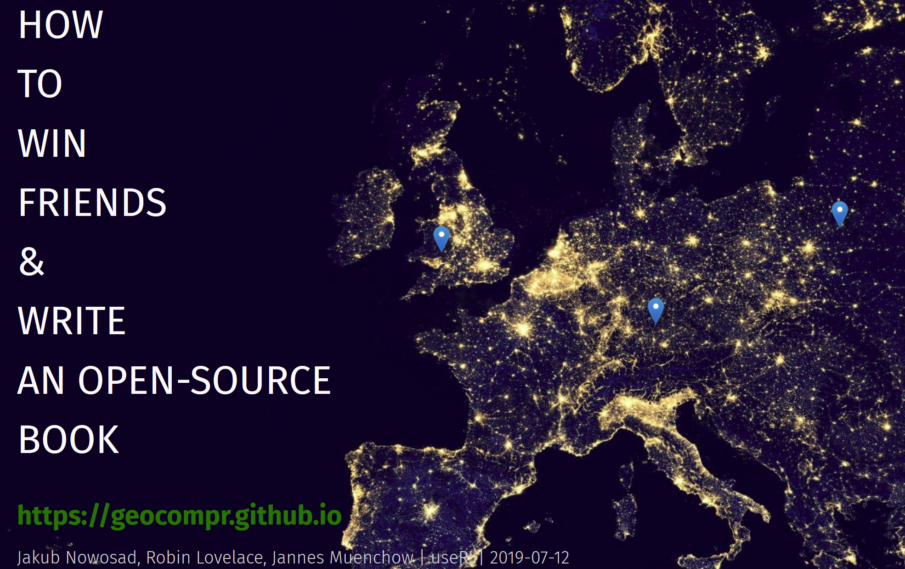
My Personal Highlights

Slide 17

Notes:
We are mainly looking for sponsors at the moment, soon we will open the call for submissions and scholarship applications

